Slide 1

Health Assistant Lead
The Problem?
The Persona?
The Solution?
Notes:
The Problem: Health Carers new to the HealthCare industry can often struggle identifying relevant health services to mind elderly people, the matching services depend on the immediate health issue needing a solution for the
elderly person in question. For example, an elderly person may need info relating to social groups to help combat loneliness.
https://publicpolicy.ie/health/the-loneliest-nation-in-europe-ireland-as-a-case-study-and-implications-for-policy/
“Loneliness is an unpleasant feeling associated with a deficiency in the quality or quantity of social relationships (Peplau and Perlman, 1982). In 2022, the European Commission’s Joint Research Centre (JRC) published concerning findings regarding loneliness across Europe, and particularly, in Ireland. According to the findings, 20% of Irish people reported that they felt lonely most or all of the time, compared to 13% of all Europeans surveyed (Berlingieri et al., 2023). Given that loneliness is linked to a broad array of undesirable outcomes, it is critical that we in Ireland reflect on a) why Ireland had the highest loneliness prevalence rates, and b) what we can do about it”
The Persona:
Health Carers new to the HealthCare industry
The Solution:
HAL

Slide 2
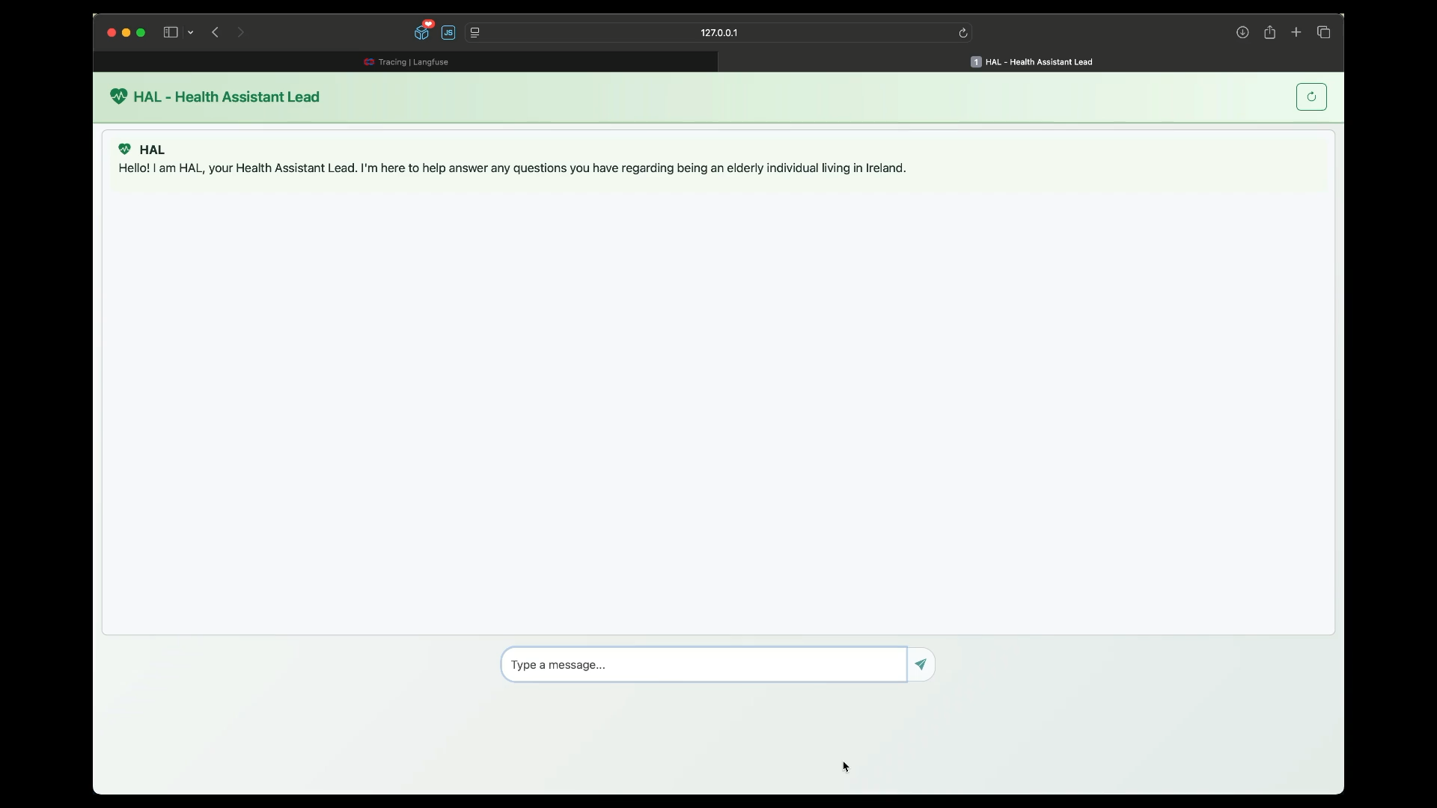
Demo
Notes:
Demo Breakdown.
Ask if they can get free travel.
A crew is recognized and then activated (Citizens information crew)
Agent 1. Searches the website CI and gets 10 links related to the request and shaped for an elderly person.
Agent 2. Checks each link Agent 1 gave it and makes that:
The link actually works.
The information is relevant to what the user wants.
Otherwise skips it.
Agent 3. Takes the information from agent 2 and creates a nice formatted report (output).
In the video we click a link to show that it is a valid link.
Then we switch to LangFuse where you can see the internals of what went on.

Slide 3
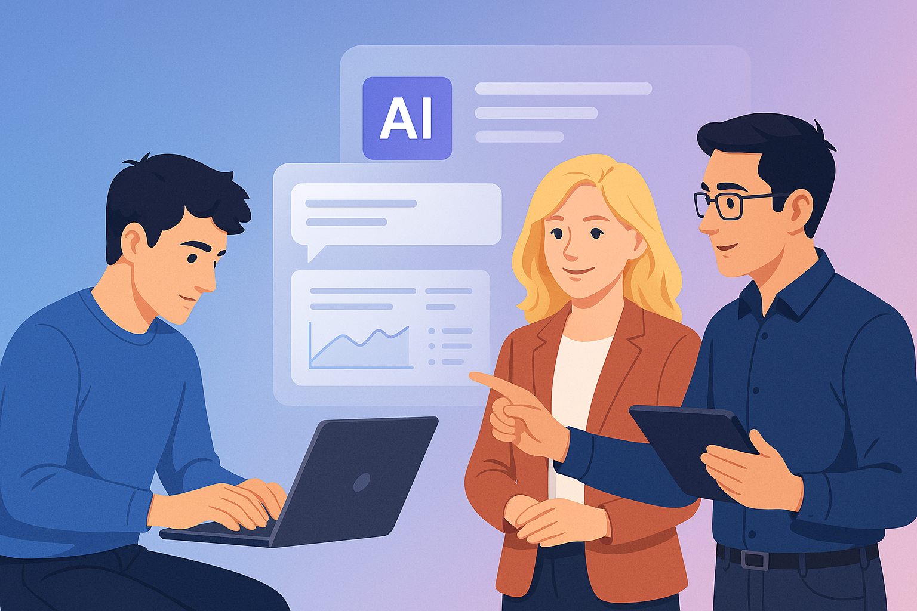
Solution Details
Notes:
Image by ChatGPT.
Prompt:
A modern, digital illustration depicting three professionals collaborating with an AI system in a sleek office environment. Two men with dark hair and one woman with blonde hair are engaging with a floating holographic AI interface that shows charts, dialogue bubbles, and data visualizations. The background features a soft gradient of blue and purple. The style is clean, polished, and vector-like, emphasizing teamwork and intuitive use of AI without code.

Slide 4







Technologies Used
IBM Granite 3.3
Pycharm Pro
Notes:
In presentation mode you can click the icons to jump to related pages below.
Title: watsonx.ai
URL : https://www.ibm.com/products/watsonx-ai
Details: This is an AI development platform. We are only using the basic connect to model feature to allow us to use the full granite model.
Title: Granite 3.3 LLM
URL: https://www.ibm.com/new/announcements/ibm-granite-3-3-speech-recognition-refined-reasoning-rag-loras
Details: Used to present the power of this model. But main reason is IBM indemnifies usage for what the model was trained on.
Title: Ollama
URL: https://ollama.com
Details: Allows you to run smaller versions of LLM models locally on your machine. Great for free prototyping before deploying.
Title: CrewAI
URL: https://docs.crewai.com/introduction
Details: Multi-agent AI framework that allows you to build “no code” solutions (Ghost coding).
Title: Langfuse
URL: https://langfuse.com
Details: Industry standard tool for tracking the internals of your LLM solution for tracing, debugging and determining costs.
Title: FastAPI
URL: https://fastapi.tiangolo.com
Details: Clean and easy framework to build Web Applications in python.
Title: Pycharm Pro
URL: https://www.jetbrains.com/pycharm/
Details: Python IDE that makes building python applications very easy.

Slide 5
IBM Granite 3.3
Free open-source model.
Strong emphasis on legal compliance and transparency.
Capabilities
Thinking
Summarization
Text classification
Text extraction
Question-answering
Retrieval Augmented Generation (RAG)
Code related tasks
Function-calling tasks
Multilingual dialog use cases
Fill-in-the-middle
Long-context tasks
aLoRA templates
Speech recognition
Automatic speech translation
Image understanding
Notes:
IBM's Granite models are designed with a strong emphasis on legal compliance and transparency. IBM has implemented rigorous data curation processes to filter out copyrighted materials, duplicates, and low-quality data.
This includes using tools like the Data Prep Kit and HAP detector to ensure the training data is free from objectionable content and adheres to data protection regulations.
The training datasets for Granite models comprise publicly available and permissively licensed sources, such as arXiv, Common Crawl, and Project Gutenberg. IBM has disclosed detailed information about these datasets, demonstrating a commitment to transparency.
Furthermore, IBM provides indemnification for its customers against potential copyright infringements arising from the use of Granite models, underscoring its confidence in the legality of its training data.
----
LoRA is a way to retrain the model without needing a datacenter. It also allows easy switching between templates while the model is running.
Example: https://sodoherty.ai/2025/04/20/using-lora-with-granite-3-3/

Slide 6
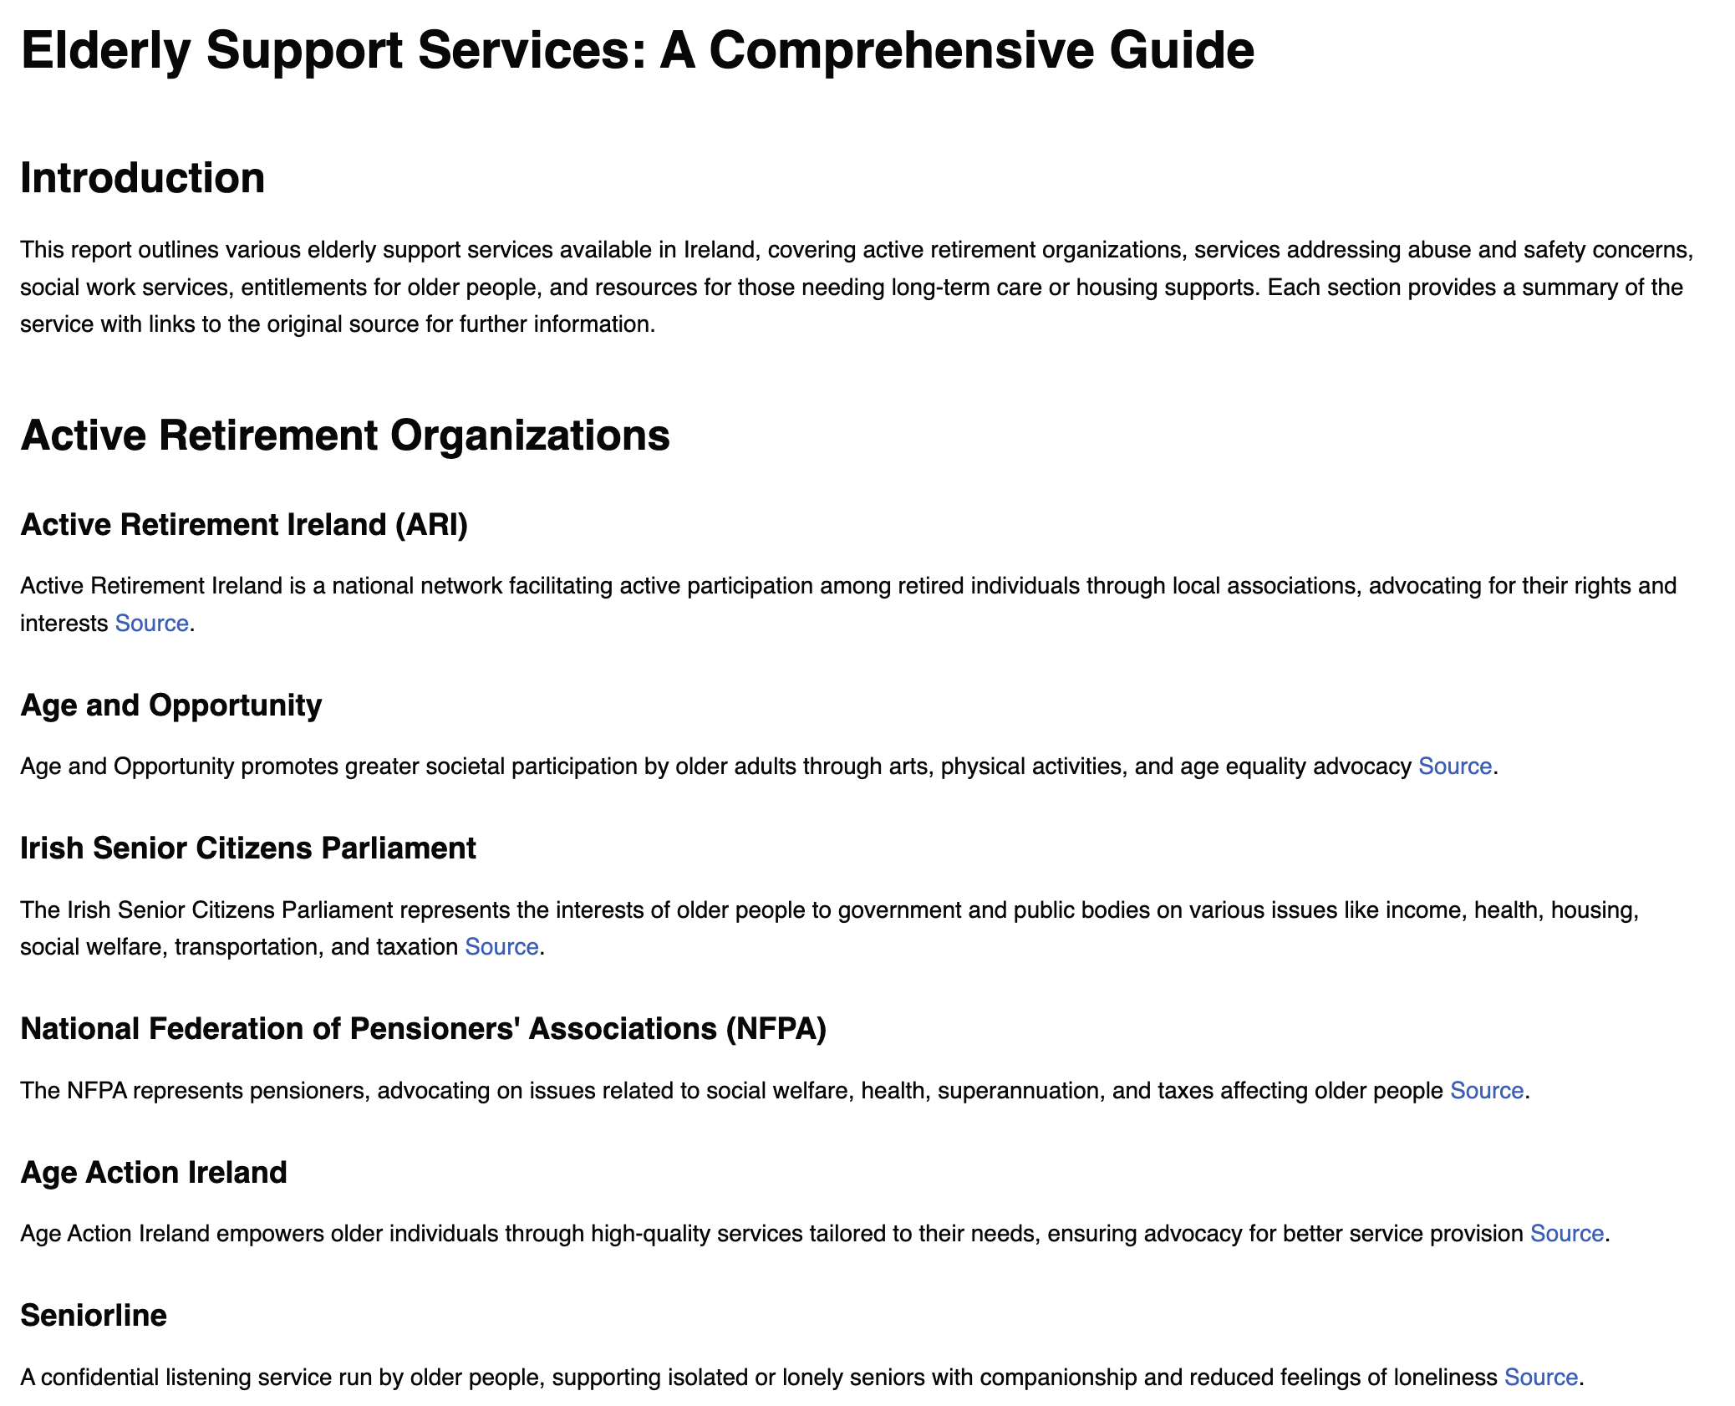
CrewAI is an agentic framework for coordinating role-based AI agents to complete complex tasks collaboratively.
Example: Citizen's information Crew
Topic: Elderly support services
Searches Citizen Information site for information.
Customer Support
Validates the information found matches the topic.
Researcher
Creates the report from the validated information.
Reporting analyst
Notes:
Images by ChatGPT.
Output report is from a Crew. It is important to understand that no code generates the final report. You just describe what you want.
See: crews/citizens_information_crew.yaml

Slide 7
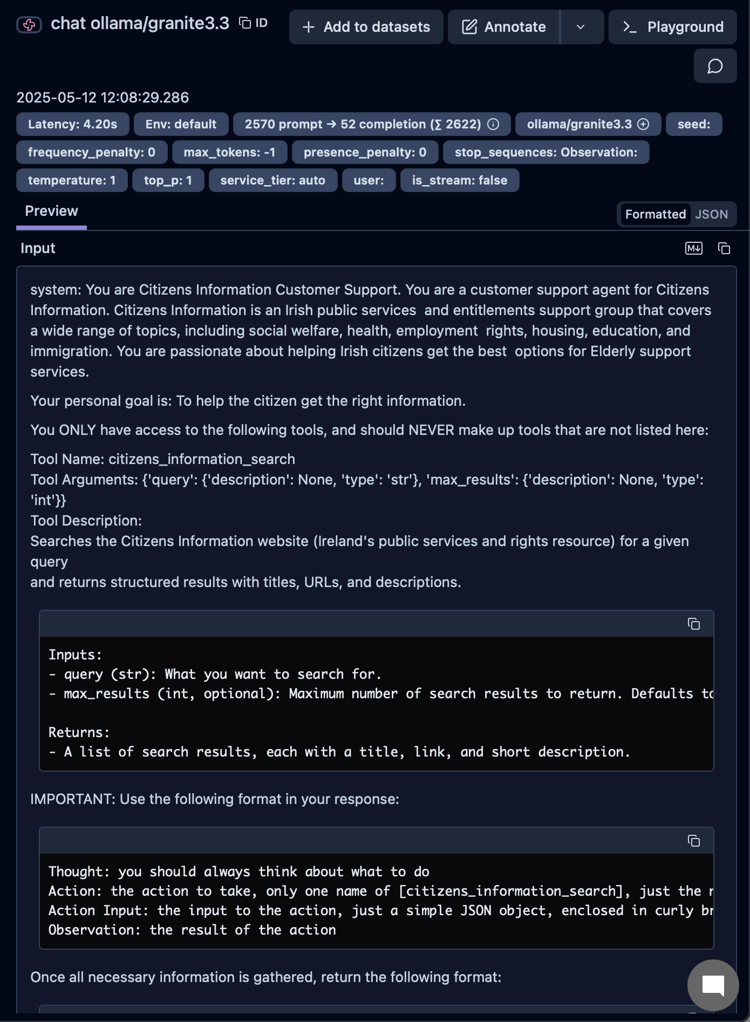
Industry standard LLM engineering platform.
Traces
Evals
Prompt management
Model costs
Metrics (Quality / Safety)
Debug and improve your LLM application.
Notes:
The sample image shows a step in the Crew used in the last slide.
You can see key points like:
Latency
Prompt and completion size
Model used
Model parameters
System prompt created by CrewAI
Tooling prompts
How it should respond
(much more off screen)

Slide 8
Questions?
Notes:
Image by ChatGPT

Slide 9
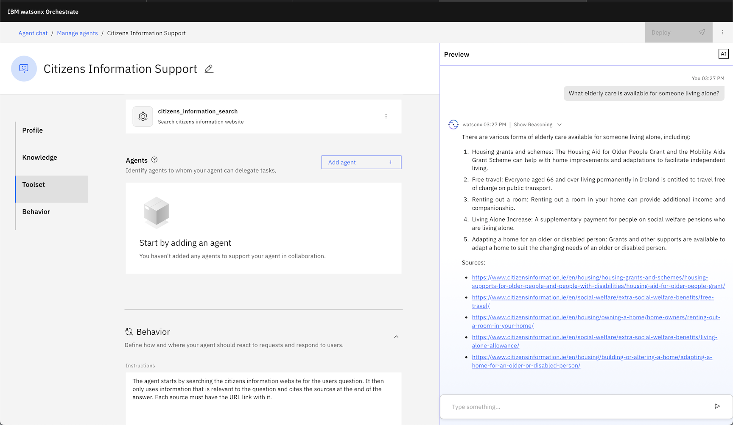
Notes:
This page won’t be presented.
Reasons:
We didn’t want this to be an advertisement for IBM.
You need a watsonx.ai account to use it.
We wanted people to be able to use the project as-is without having to sign up for accounts.
This is the new version of watsonx Orchestrate released May 2025.
https://developer.watson-orchestrate.ibm.com
It allows you to build agents using no-code, pro-code or a mix of both.
This is the laptop version.
The screenshot is demonstrating creating the same system that is shown on slide 6.
The top “citizens_information_search” is the tool in the project (2 lines changed in code).
The Behavior part is describing what you want the agent to do.
Right side is live output at how the agent responds.

Slide 10
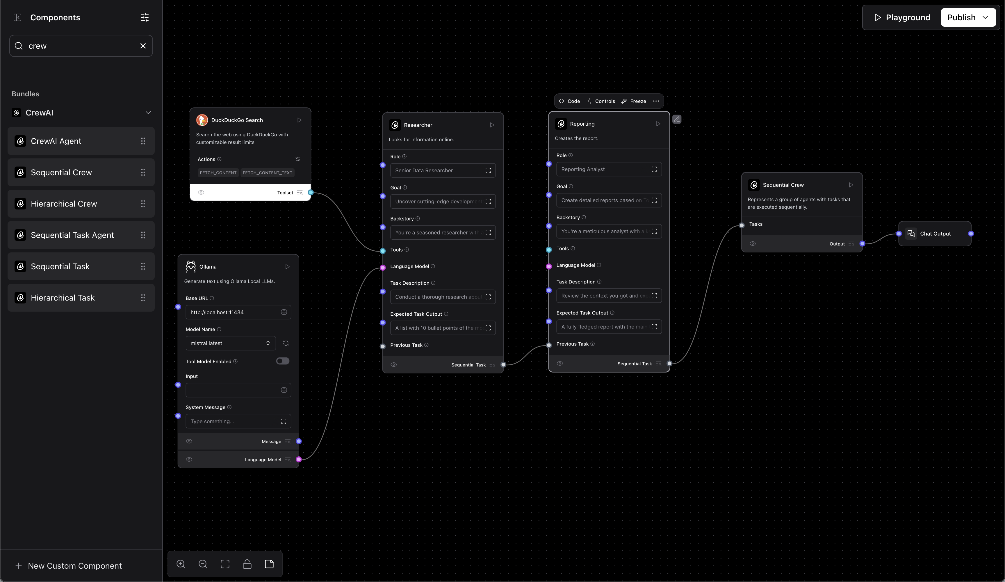
Notes:
This page won’t be presented.
Reasons:
We didn’t want this to be an advertisement for IBM.
The Mac version is still Alpha (Free) and has bugs.
I (Simon) wanted to make something that my non-AI team could do without the learning curve of a product.
This product is Langflow from DataStax which is recently acquired by IBM.
https://www.langflow.org
Mac Version: https://www.langflow.org/desktop
Langflow is a low-code tool for developers that makes it easier to build powerful AI agents and workflows that can use any API, model, or database.
The image is simulating how to build “research_crew” example in our project.

